Slide 1




Your Home, Remembered™
The AI-Powered Cleaning Revolution
Platform Built
Team Assembled
Ready to Launch
$100K Convertible Note | North Dallas Launch

Slide 2

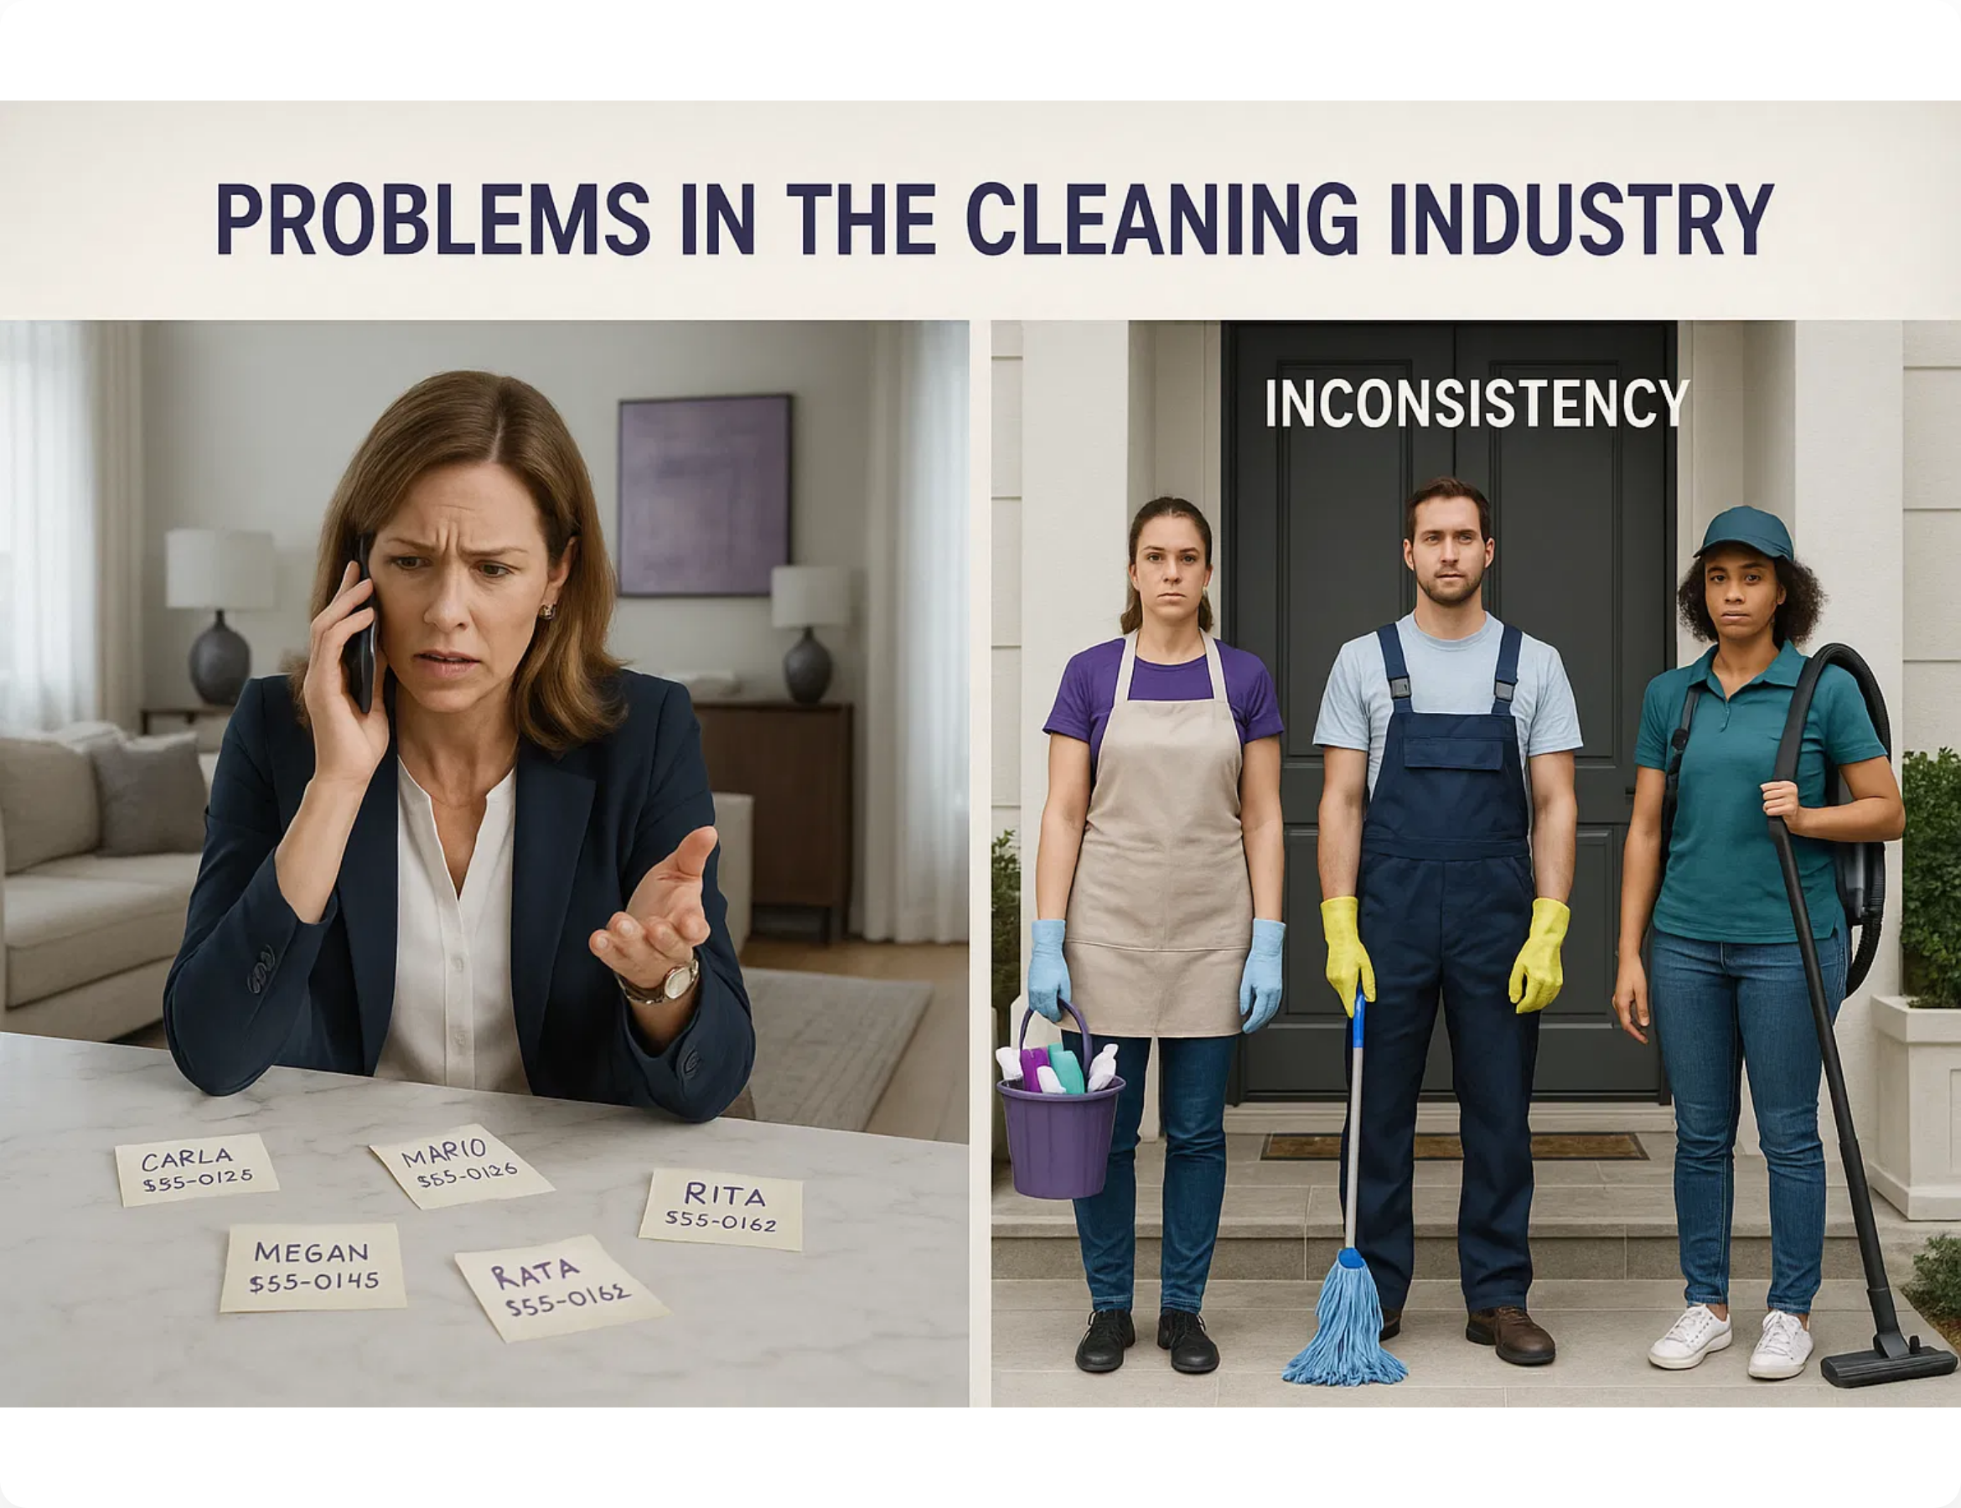





Problems in the Cleaning Industry
"Every cleaning service treats your home like it's their first time"
Inconsistency:
Different cleaner each time, no memory of
preferences
Trust deficit:
Strangers in homes with no accountability
Price opacity:
Hidden fees, unclear pricing structure
Poor technology:
Manual scheduling, no digital experience
North Dallas Market Reality:
842,691 residents
85,500 target households
$96K-$142K median income
ZERO tech-enabled cleaning services

Slide 3
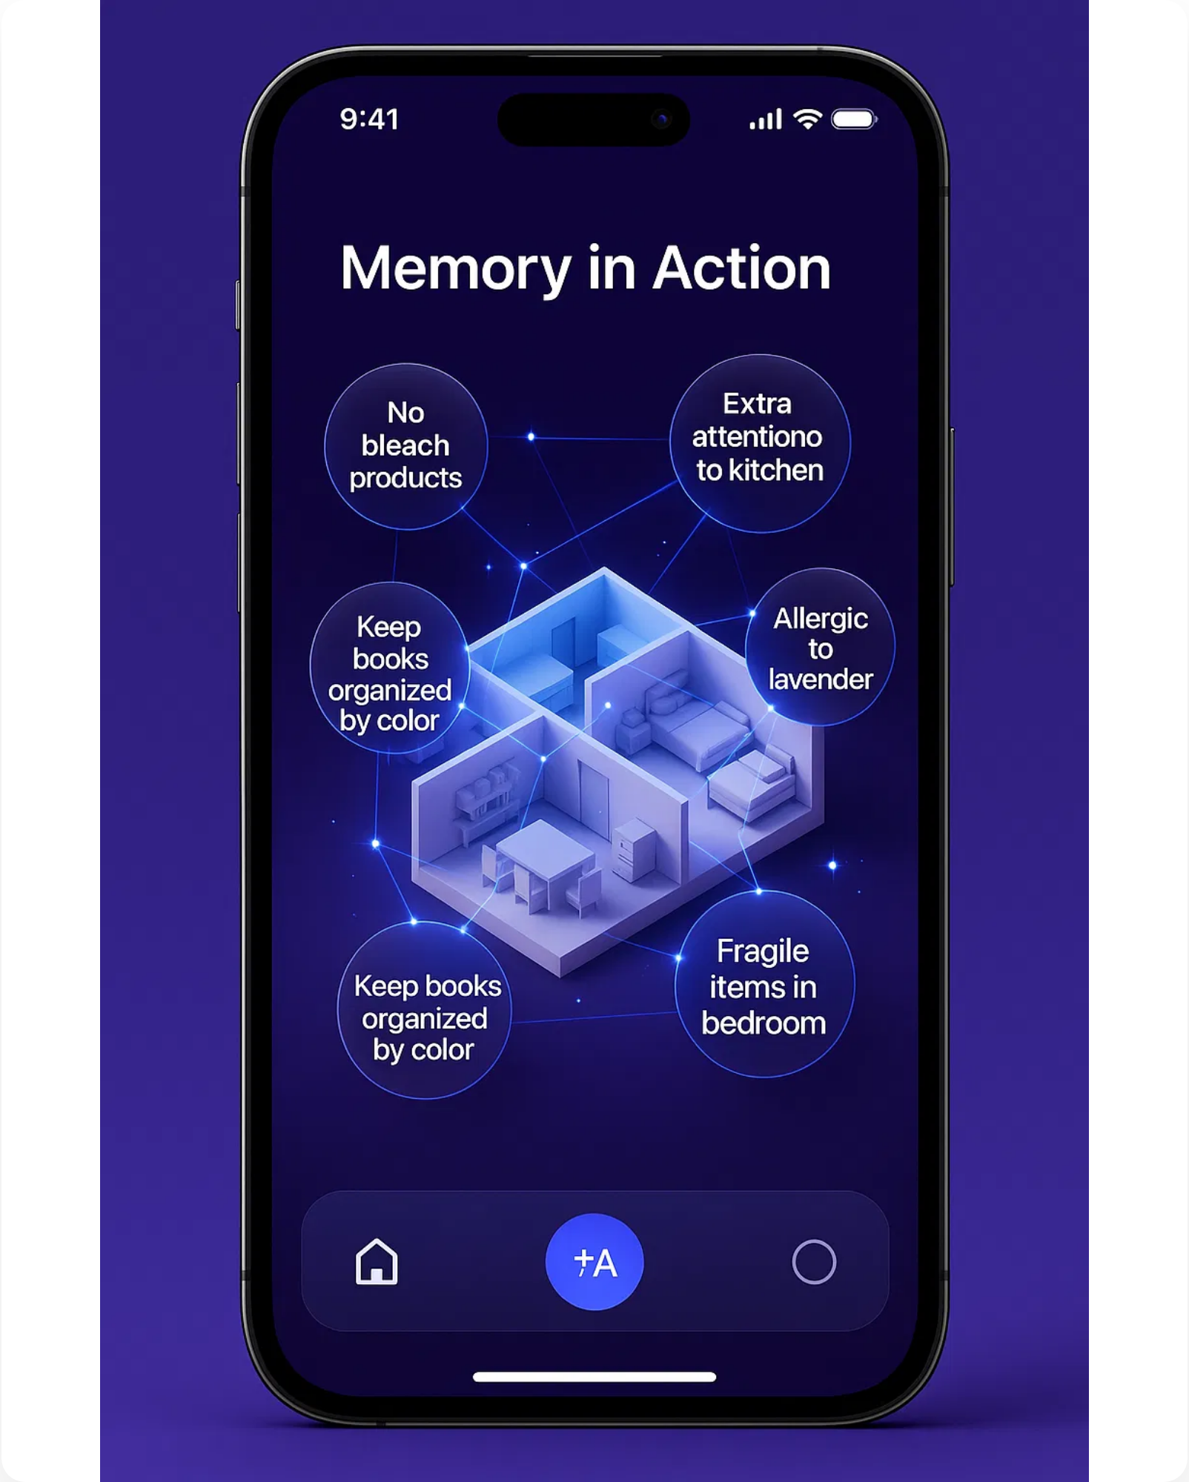





Maidly.ai: The Cleaning Service with a Memory
AI-powered system that remembers every detail of your home
AI Memory System
Remembers where items belong, preferred products, and special instructions
Learning Loop
Improves service quality through feedback analysis and continuous learning
Predictive Analytics
Suggests optimal cleaning frequency and services based on usage patterns
Crew Briefings
AI-generated personalized instructions for each visit
Same Team Consistency
Consistent crew assignment builds trust and familiarity

Slide 4

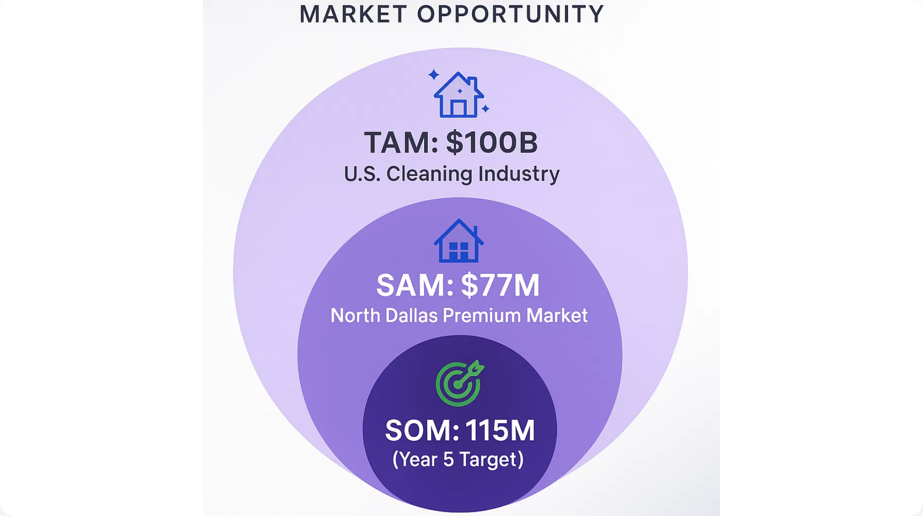



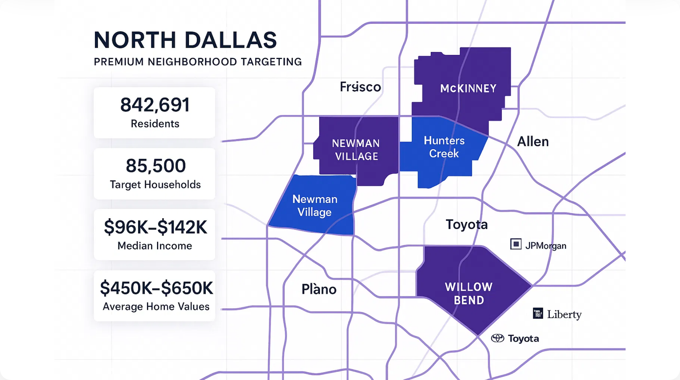



Market Opportunity
Massive Market, Perfect Timing
Market Size
TAM:
$100B U.S. Cleaning Industry
SAM:
$77M North Dallas Premium Market
SOM:
$15M (Year 5 Target)
North Dallas Demographics
842,691
residents across Frisco, McKinney, Allen & Plano
85,500
target households (top 30% income tier)
$96K-$142K
median household income

Slide 5




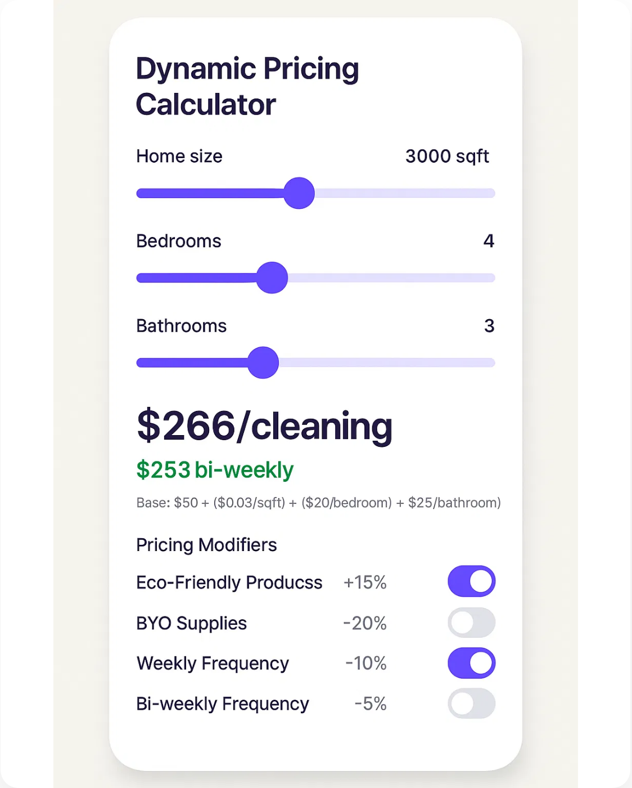

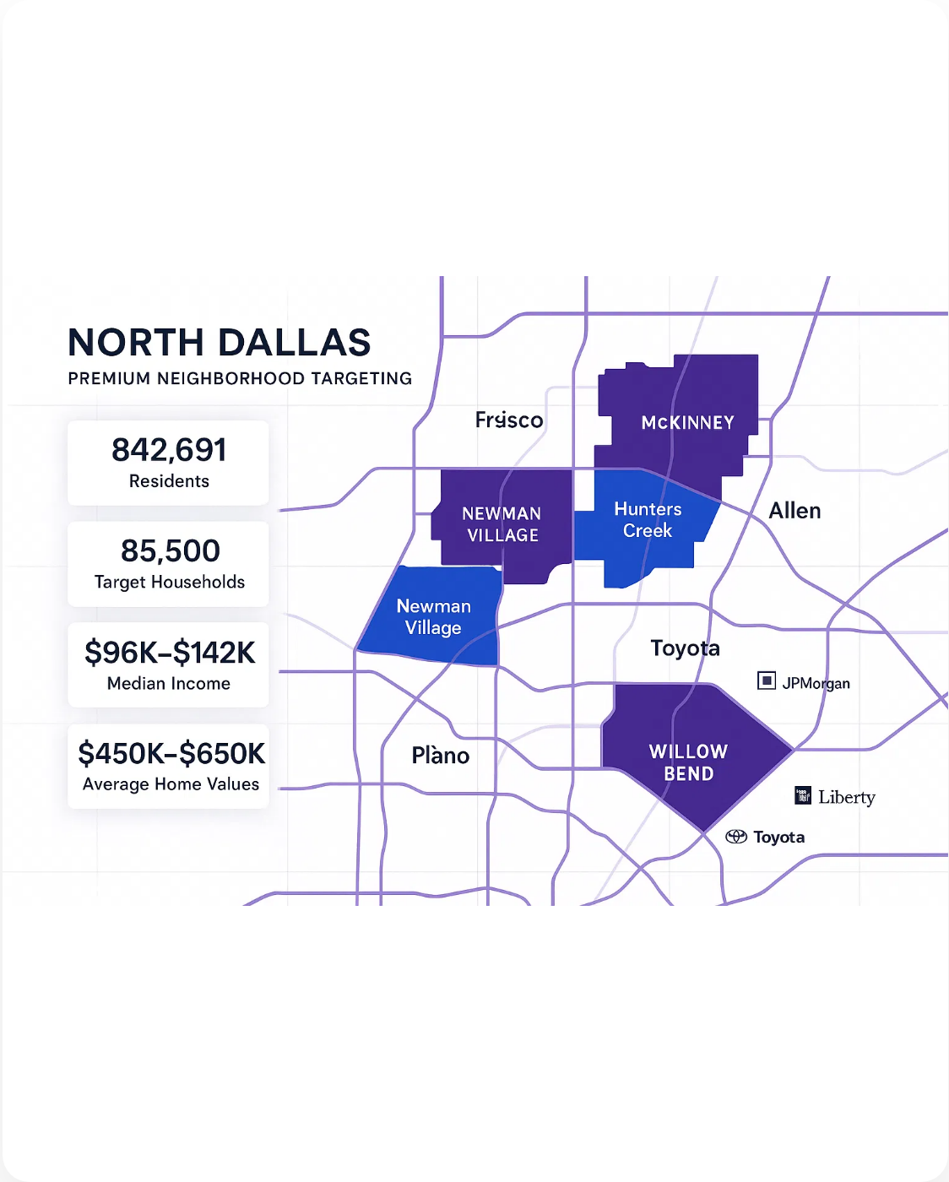
How It Works
Simple 3-step process powered by AI
1
2
3
Smart Booking
AI Learning
Perfect Service
Instant scheduling, transparent pricing, preference selection
Captures details, builds preference profile, improves each visit
Crew gets AI briefing, follows exact preferences, customer rates and refines

Slide 6
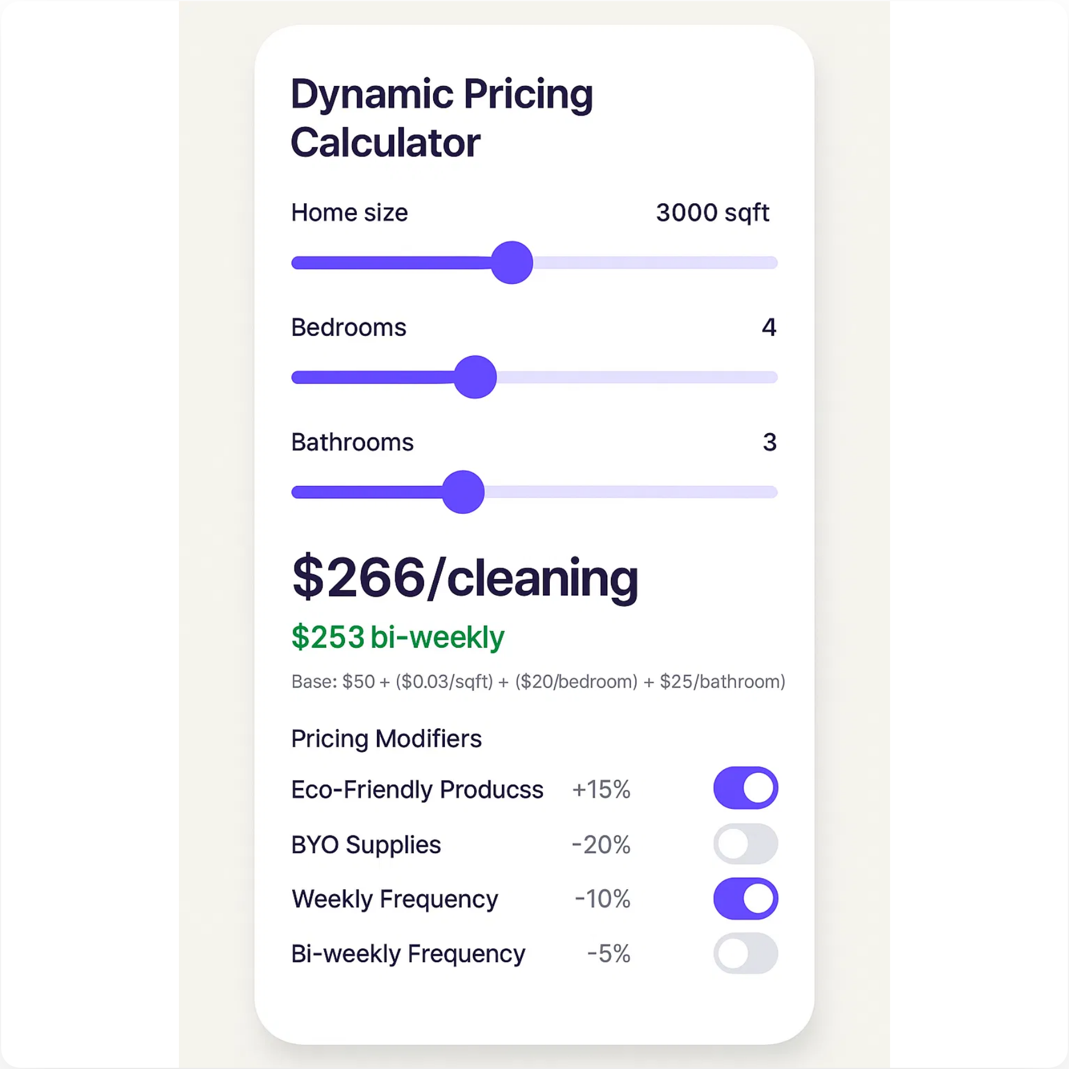
Smart, Transparent Pricing
Dynamic pricing model based on home size and features
Dynamic Pricing Formula
Base: $50 + ($0.08/sqft) + ($20/bedroom) + ($25/bathroom)
Real Examples
2,000 sqft (3BR/2BA)
3,000 sqft (4BR/3BA)
4,500 sqft (5BR/4BA)
$186
$266
$376
$177 bi-weekly
$253 bi-weekly
$357 bi-weekly
Pricing Modifiers
Eco-Friendly Products
+15%
BYO Supplies
-20%
Weekly Frequency
-10%
Bi-weekly Frequency
-5%
Unit Economics
$253
65%
$75
81:1
Average Ticket
Gross Margin
CAC
LTV/CAC

Slide 7
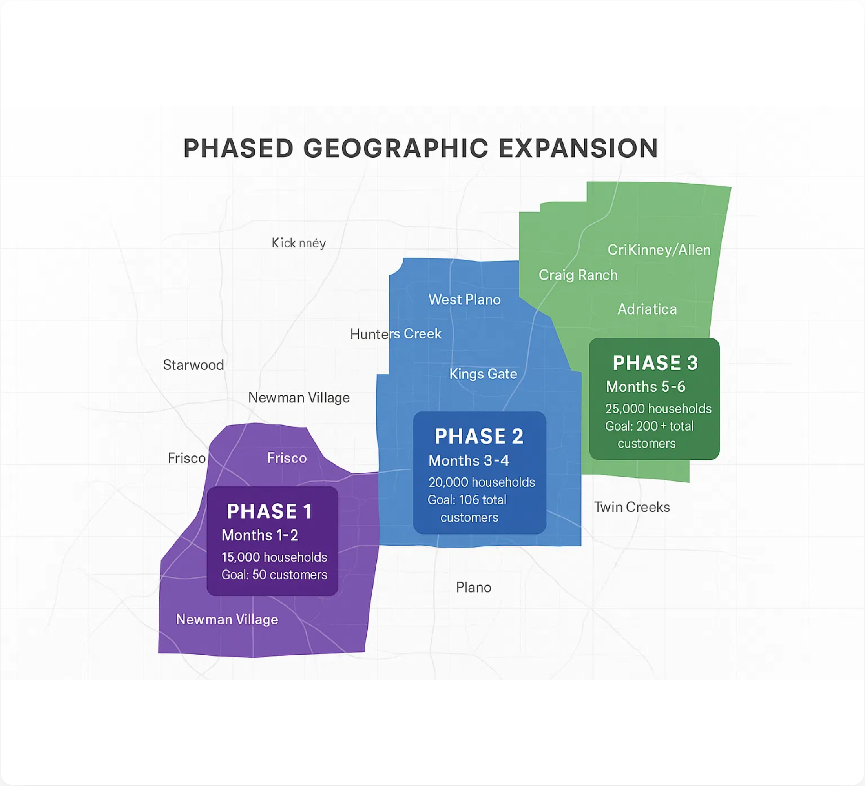





Neighborhood Conquest Strategy
Phased rollout across North Dallas premium neighborhoods
Phased Expansion
Phase 1: Frisco
Months 1-2
Target:
Starwood, Newman Village, Panther Creek
15,000 households
Goal:
50 customers
Phase 2: West Plano
Months 3-4
Target:
Willow Bend, Hunters Creek, Kings Gate
20,000 households
Goal:
100 total customers
Phase 3: McKinney/Allen
Months 5-6
Target:
Craig Ranch, Adriatica, Twin Creeks
25,000 households
Goal:
200+ total customers
Acquisition Channels
Facebook/Instagram Ads
Corporate Partnerships
Real Estate Agents
Nextdoor Marketing
$50 Referral Program

Slide 8

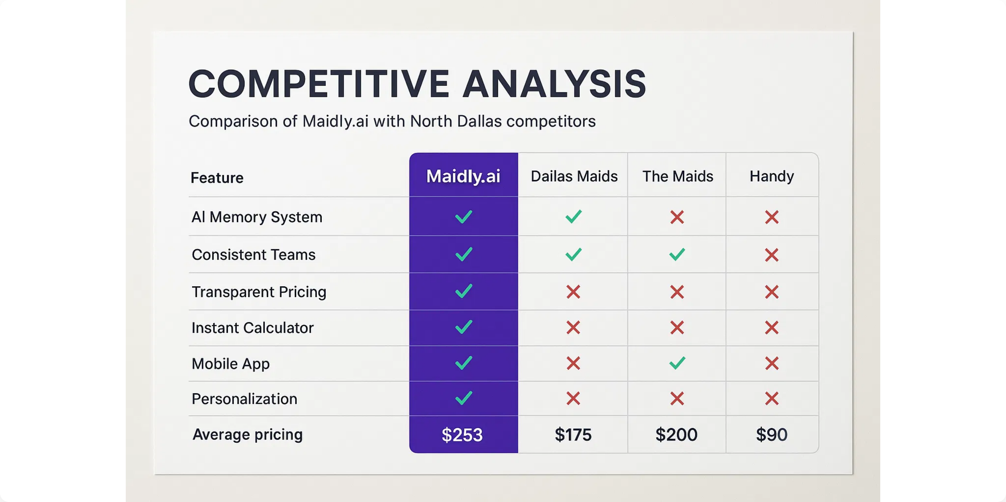



Competitive Analysis
The Only AI-Powered Cleaning Service in North Dallas
Data Network Effects
Switching Costs
First Mover
More customers → better AI → superior service → more customers
Customers lose their trained AI preferences when switching services
12-18 month head start on AI implementation in cleaning services

Slide 9





Proof Points
Honest assessment of our current status and validation
Product Ready
Market Validated
Team Assembled
Full platform built and operational
Comprehensive competitive analysis completed
Board: Harrison (Chairman), Tim (CEO), Ian (Tech)
Next.js, React, TypeScript stack
Stripe integration live for payments
85,500
target households identified
Founding Partner Program launched
AI memory system operational
Zero
AI-powered competitors in
Chief Maid candidate identified
market
Equity structure finalized
Dynamic pricing calculator functional
Clear pricing advantage with dynamic model
Corporate partnerships in discussion
Neighborhood targeting strategy validated

Slide 10
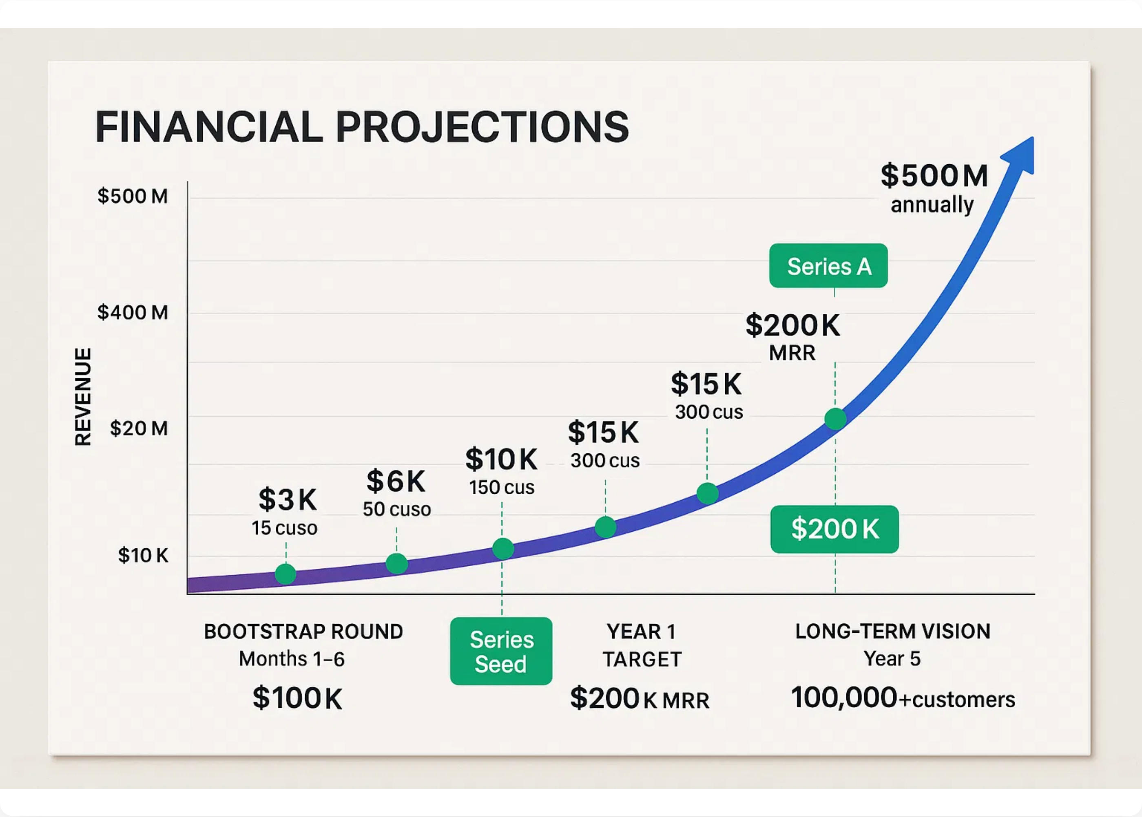


Financial Projections
Path to $500M Revenue
Bootstrap Phase (6 Months)
Month 1:
15 customers, $3K revenue
Month 3:
50 customers, $10K revenue
Month 6:
200+ customers, $40K+ revenue
Month 6 Profit:
$15K+
Series Seed Phase (Year 1)
Target Customers:
1,000
Monthly Revenue:
$200K MRR
Monthly Profit:
$50K
Retention Rate:
85%
Long-Term Vision (5 Years)
Annual Revenue:
$500M
Markets:
50+ cities across U.S.
Active Customers:
100,000+
Target Valuation:
$5-10B

Slide 11
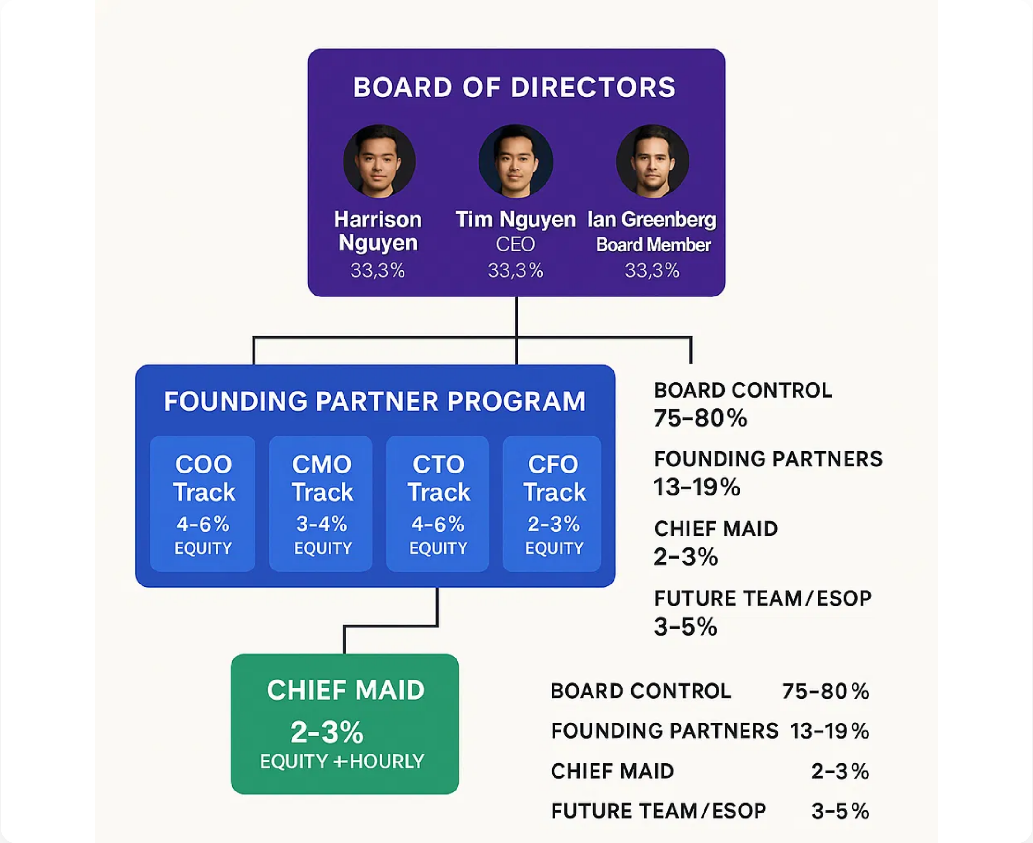




Board & Leadership
Strategic leadership with operational execution
Board of Directors
H
Harrison Nguyen
33.3%
Chairman of the Board
T
Tim Nguyen
33.3%
CEO & Board Member
I
Ian Greenberg
33.3%
Board Member & Strategic Advisor
Founding Partner Program
COO Track
CMO Track
4-6% equity
3-4% equity
CTO Track
CFO Track
4-6% equity
2-3% equity
Equity Distribution
Board Control:
75-80%
Founding Partners:
13-19%
Chief Maid:
2-3%
Future Team/ESOP:
3-5%

Slide 12
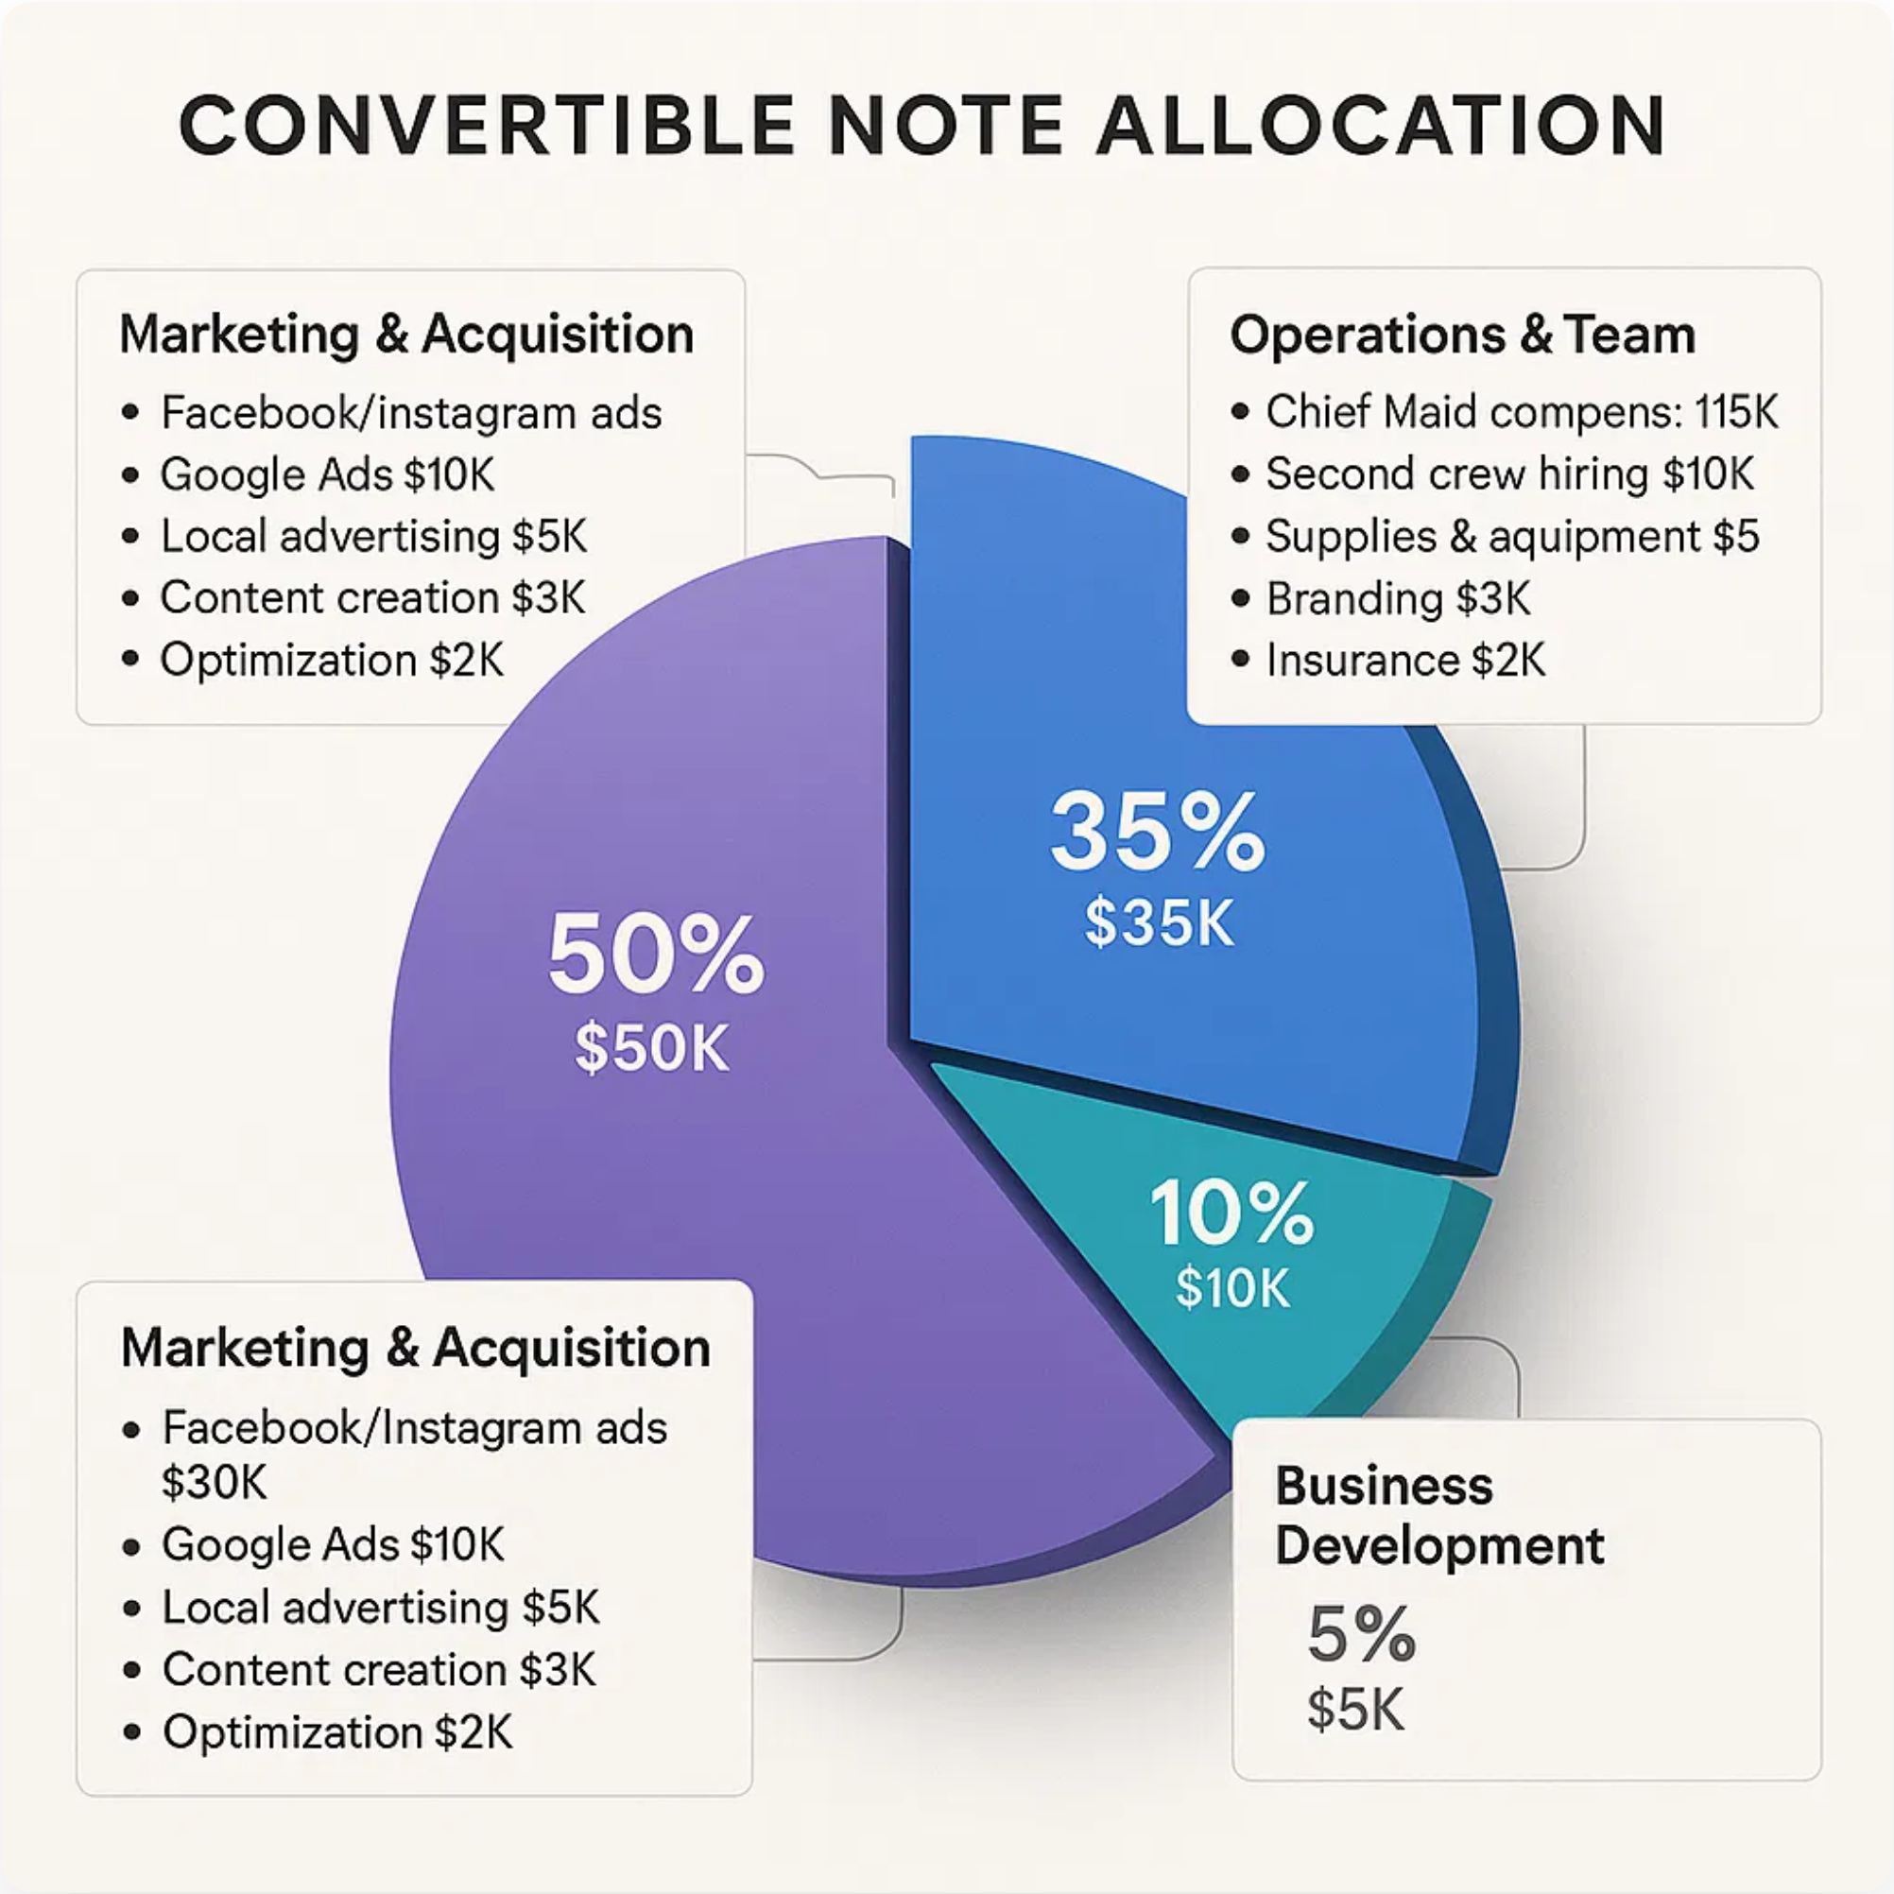








$100K Convertible Note
Strategic capital to accelerate growth
Convertible Note Terms
25% discount
to Series Seed
6% interest
, 24-month maturity
Converts at
$1M+ qualified round
Series Seed target:
$5-10M pre-money
What This Gets You
Ground floor of billion-dollar opportunity
25% discount to $5-10M Series Seed valuation
Proven team with built platform
First-mover in massive market

Slide 13

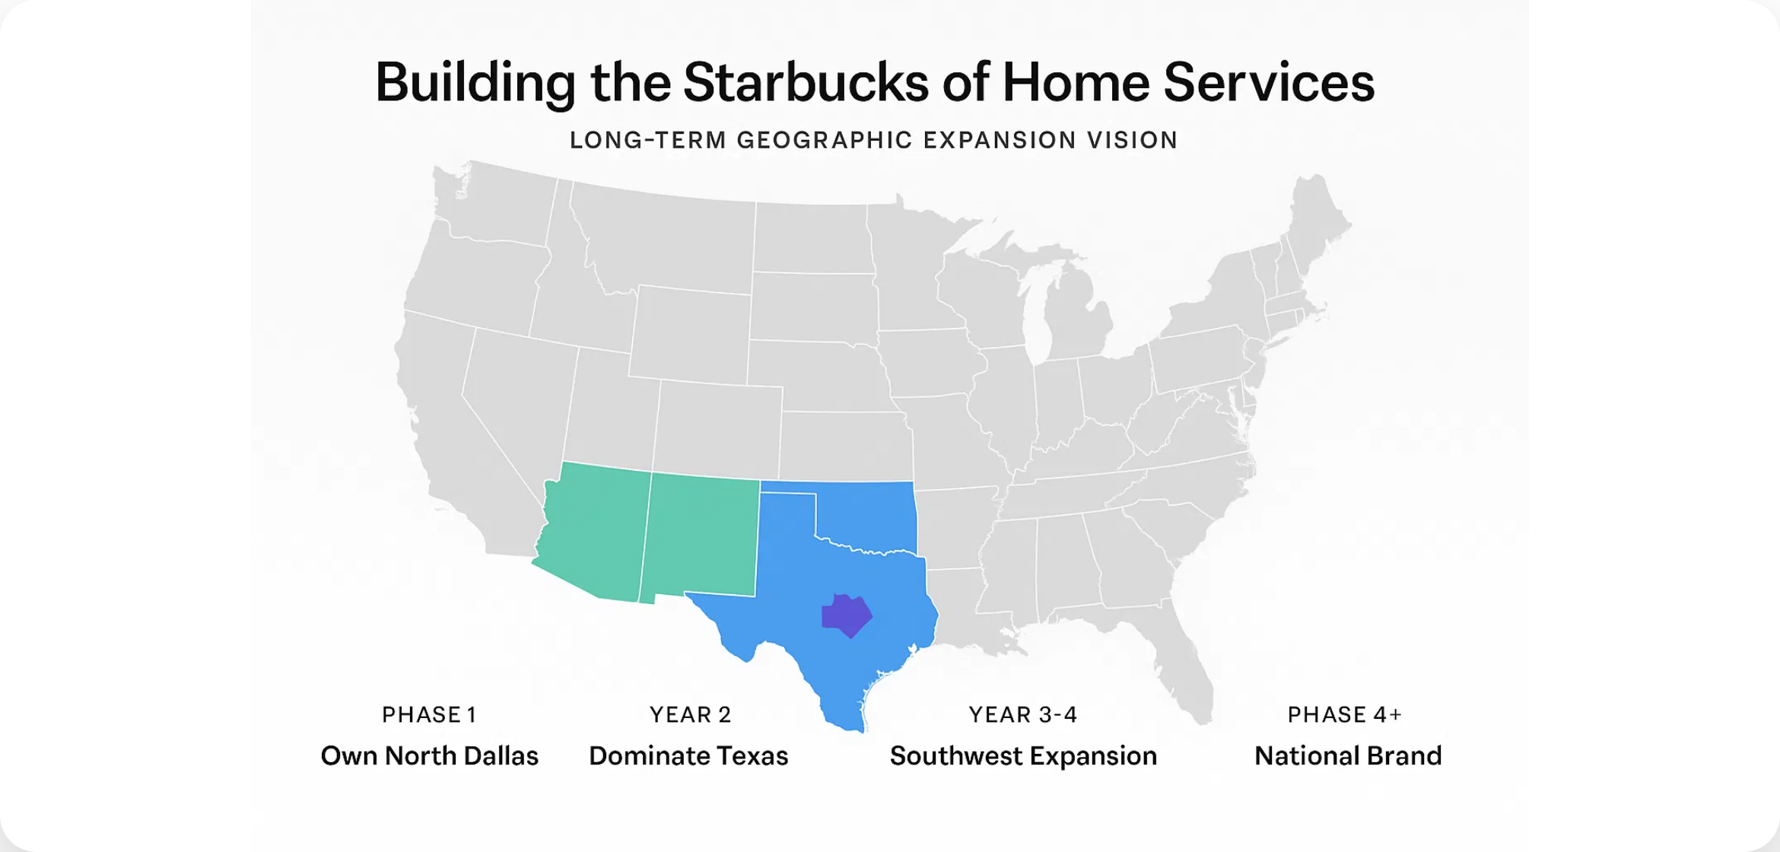
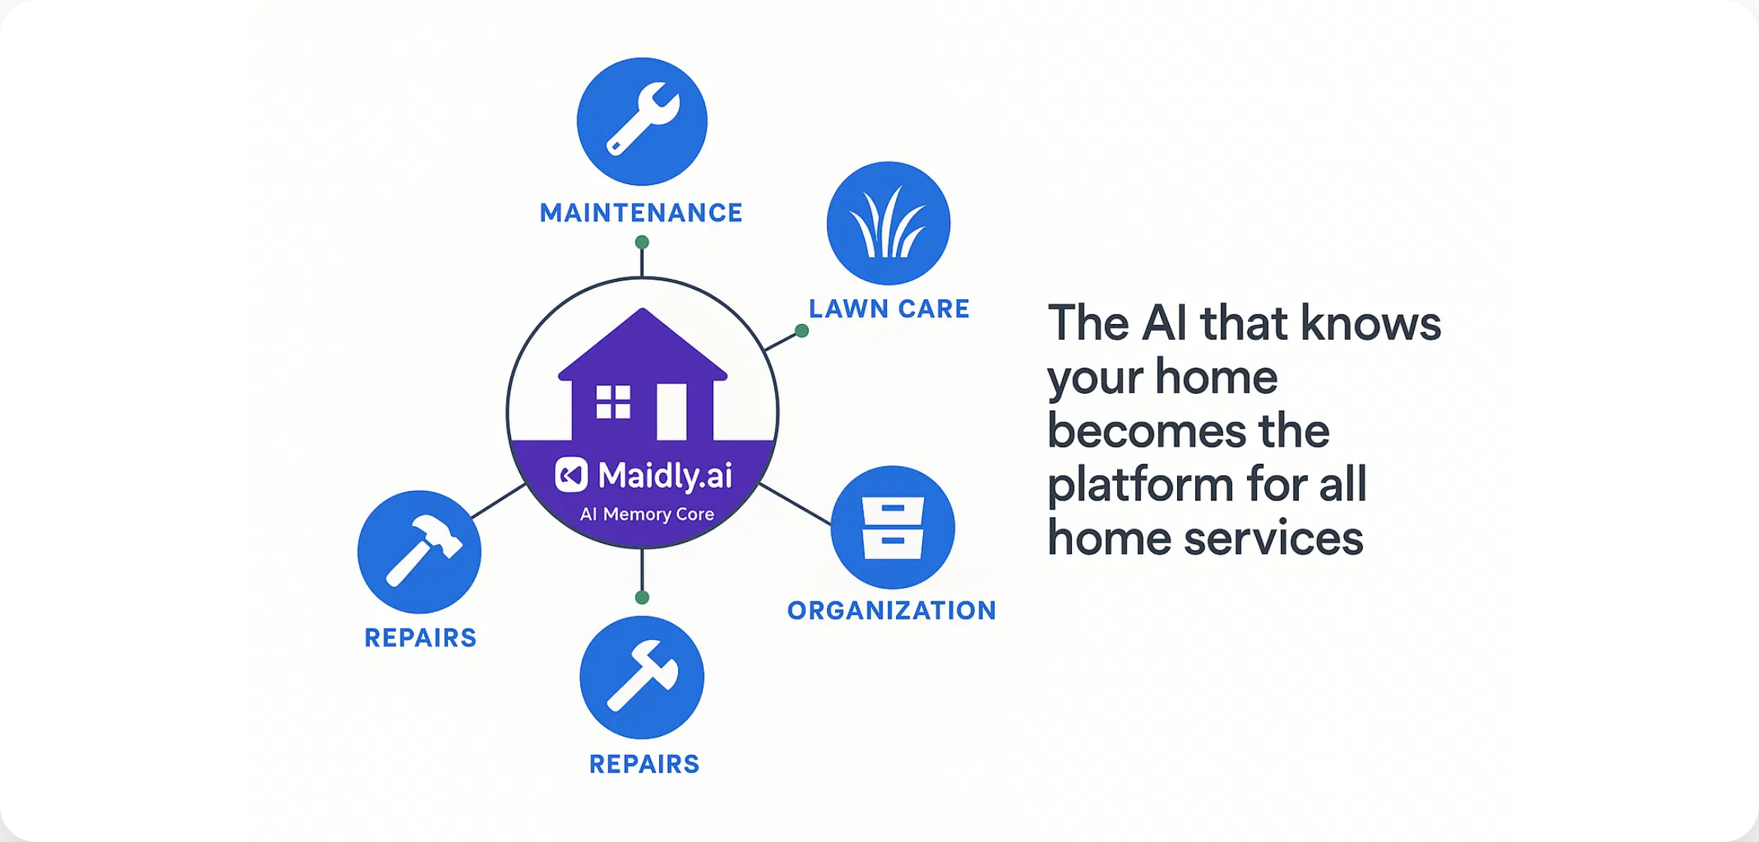




Building the Starbucks of Home Services
From Dallas to National Brand
Geographic Expansion
Beyond Cleaning
Year 1:
Own North Dallas
The AI that knows your home becomes the platform for all home services
Year 2:
Dominate Texas (Austin, Houston, San Antonio)
Years 3-4:
Southwest expansion
Maintenance, Lawn care, Organization, Repairs
Year 5+:
National brand
Exit Opportunities
Strategic Acquisition
Financial Exit
Years 3-5: Amazon, Google, ServiceTitan, Angi
Years 5-7: PE Rollup, IPO
$1B-$3B
$500M-$1B

